Slide 1
Explanatory Data Analysis of UKDALE
ASMR group presents

Slide 2
Lets choose house#4

Slide 3
Lets choose house#4
REASON
Moderately Sized (only 183MB/16.9GB)
[Spoiler] Has missing data case (So, we can use our CSE445 knowledge to handle those)
Users uses the appliances much more than the other small data house#3. [One of the user is a retired person this might be the reason of moderate use of the appliances as he possibly stays home.]
The size and computational cost of handling this house data is within our logistics.
There are 205 days of records and the samples have moderate uptime when sampling.
Lower number of channels (only six)

Slide 4
House#4’s Overall details
INSIGHTS
Channel# | Device Names | Recorded Datapoints
1 | Aggregate [Full house] | 21,86,445 Rows
2 | TV + DVD + Digibox + Lamp | 21,56,166 Rows
3 | Kettle + Radio | 21,71,769 Rows
4 | Gas Boiler | 21,98,130 Rows
5 | Freezer | 21,94,863 Rows
6 | Washing Machine + Microwave + Breadmaker | 21,80,829 Rows
The recorded data points are much higher order, which would in the future help us if we were to down-sample the dataset [Heads up: We did eventually down-sample them.]
We could use the aggregate channel as it is the aggregation of the house demand, but we need to visualize it first to check if it is indeed true.

Slide 5
Each Channel Has Two Columns
INSIGHTS
Timestamp | Power Demand (in Watt.)
1362818413 | 625
1362818419 | 625
…
…
1380582907 | 270
The important observation here is that the timestamp is not human-readable and it causes problem in our EDA process, so lets change that.

Slide 6
Each Channel Has Two Columns
INSIGHTS
Datetime | Power Demand (in Watt.)
2013-03-09 14:40:13 | 625
2013-03-09 14:40:19 | 625
…
…
2013-10-01 05:15:07 | 270
First date of measurement=2013-03-09; Last date of measurement=2013-10-01
So 205 days of data
Another important observation is that the timestamp has
a MINIMUM frequency of 6 seconds.
So, if we were to resample the dataset, we have to keep the base sampling rate (6s) in our mind.

Slide 7
Lets visualize the raw channels

Slide 8
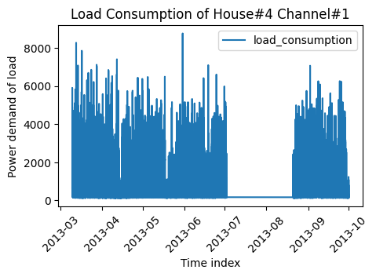
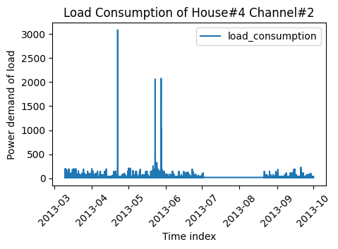
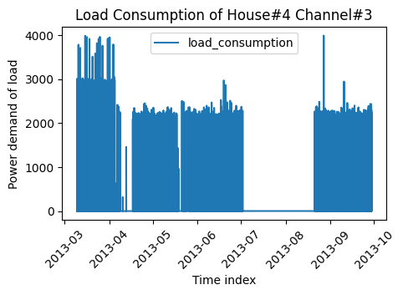
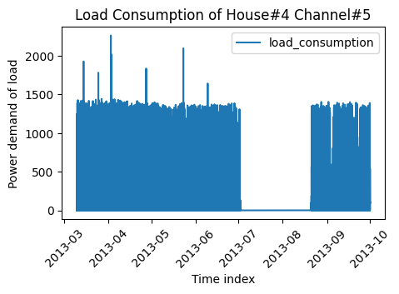
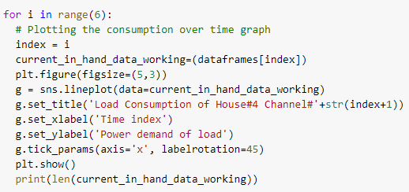
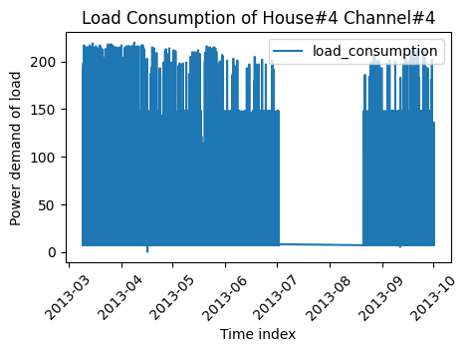
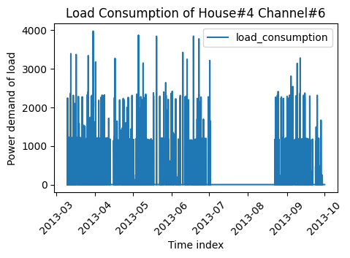

Slide 9
INSIGHTS
There are missing values (July 2013-August 2013). We have to beware of this missing value pitfall when we are forecasting the power demand.
The Missing values are somewhat at near the ending of the timeframe, so we can just delete the portion (July 2013 onwards) to handle the missing data.
The plots doesn’t look like any traditional time series line-plot; Reason: very high frequency (6 seconds). Solution: reduce the frequency by resampling (down-sampling)

Slide 10
Lets handle the missing values

Slide 11
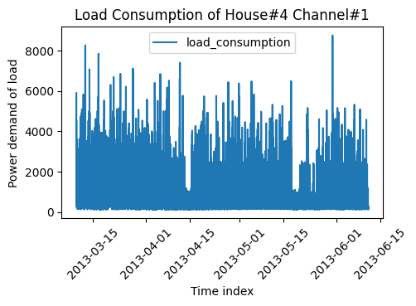
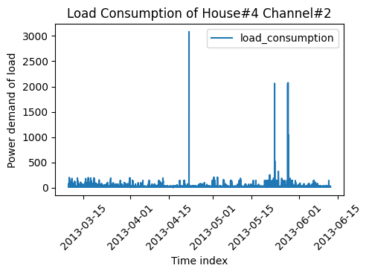
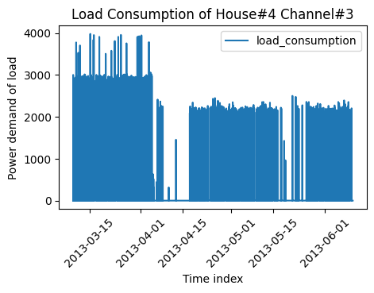
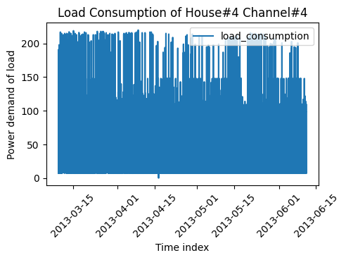
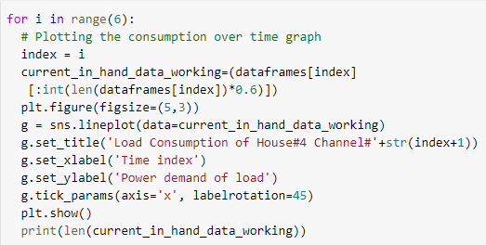
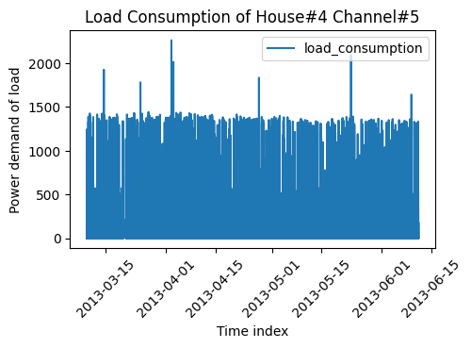
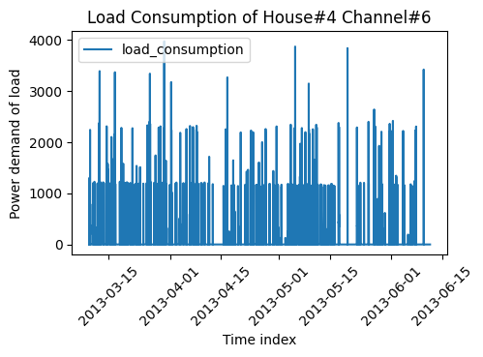

Slide 12
INSIGHTS
Cutting down the 40% (Hyperparameter) datapoint from the rear-end helped and now the missing datapoints problem is solved.
But we still have a very high frequency and we need to resample the points.
Now that the plots are more clear, we can see that channel#4 (Gas boiler) was used more frequently than any other channel.

Slide 13
Lets resample the channels into different frequency
Plan:
Hourly (1h, 6h, 12h)
Daily (24h)

Slide 14
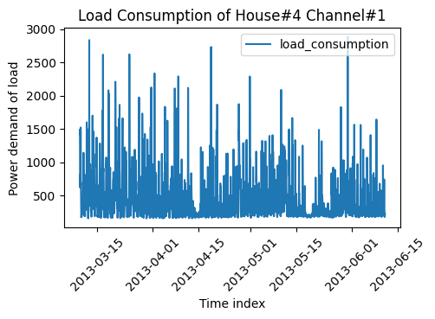
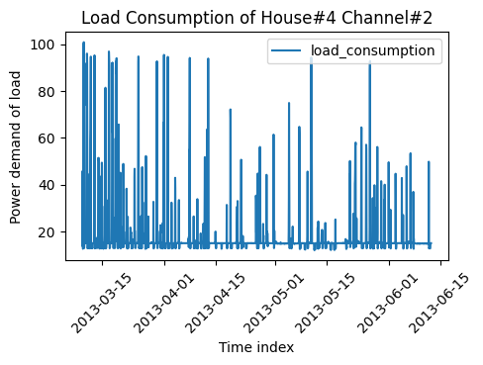
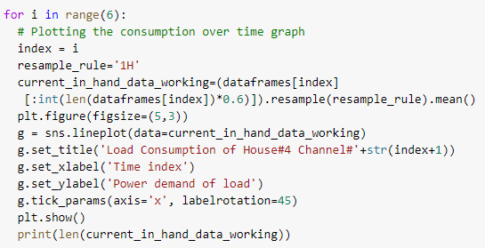
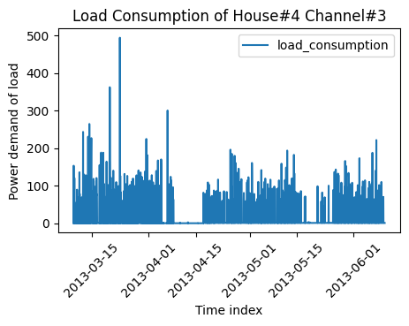
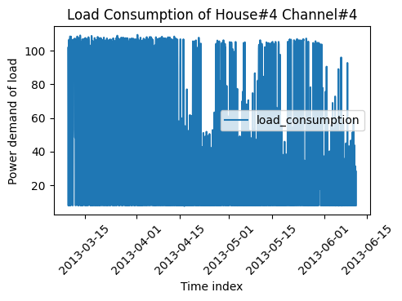
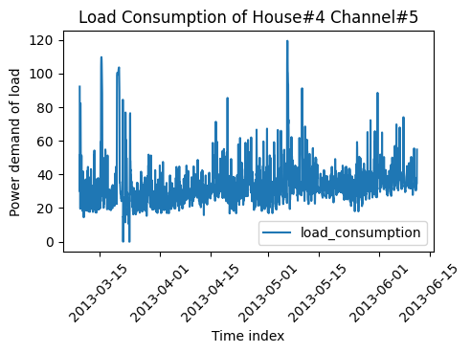
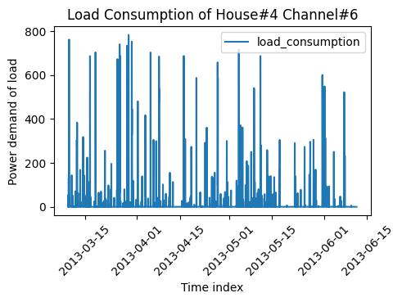
Sample Rate: 1 Hour

Slide 15
INSIGHTS
After the resampling (sample rate = 1h) the Channel#5 now looks somewhat like a traditional time-series data.
Except the channel#5, other channels still needs some more resampling.
There are some seasonal patterns visible in the channel#1.
Channel#4 was frequently used than any other channel, however, channel#4 doesn’t consume much energy because of the range of the y-axis.
Sample Rate: 1 Hour

Slide 16
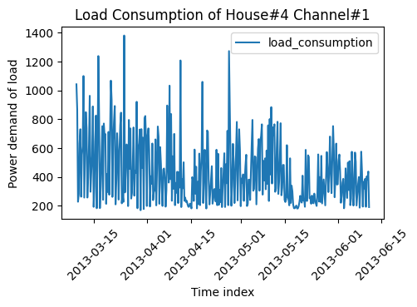
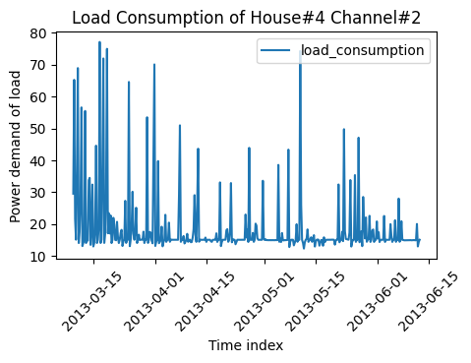
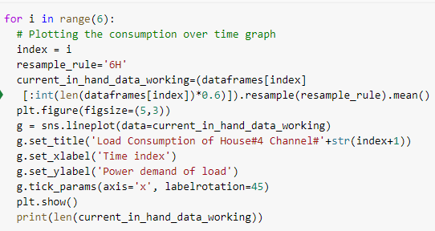
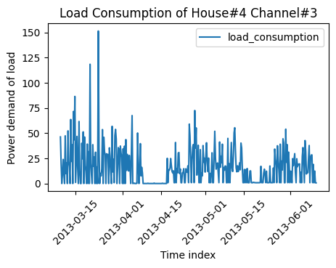
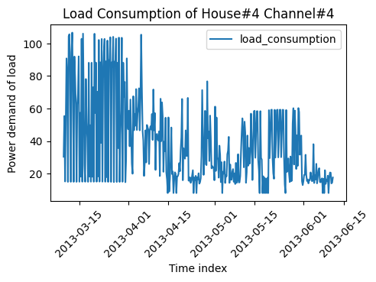
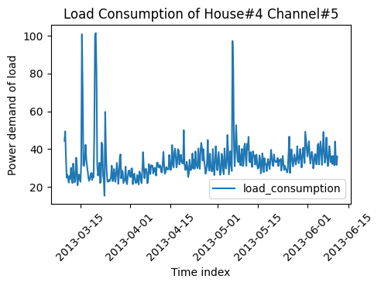
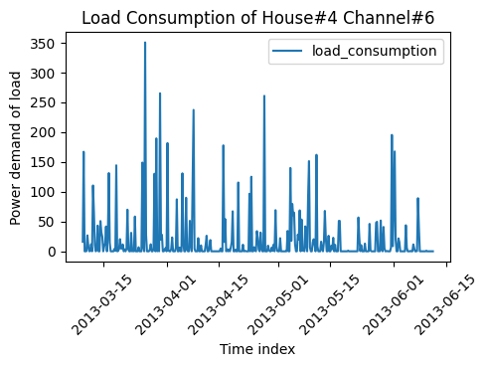
Sample Rate: 6 Hour

Slide 17
INSIGHTS
After the resampling (sample rate = 6h) the Channel#4 now also looks somewhat like a traditional time-series data after march 2013 onwards.
The channel#2,3,6 always moves forward by closely sticking to the zero line (x-axis) which tells a very important observation: “these channels are not frequently used.”
There are somewhat spike of power consumption in mid-march and third quarter of the April in the aggregate channel#1: “reason may be that at that time it was summer in UK.”
Sample Rate: 6 Hour

Slide 18
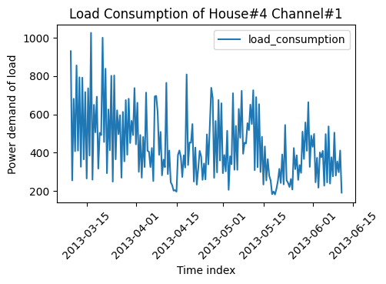
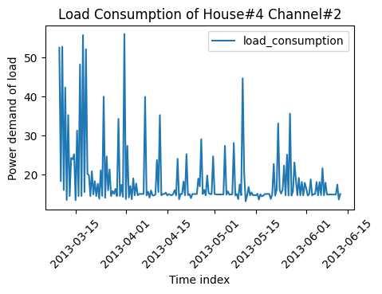
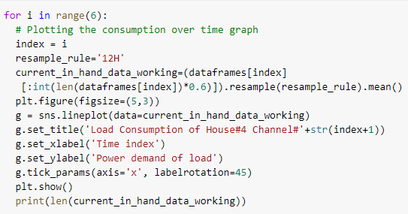
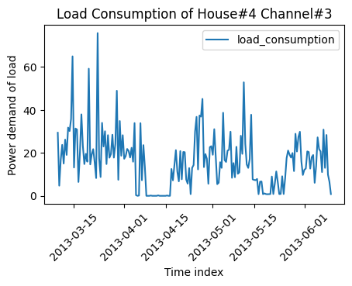
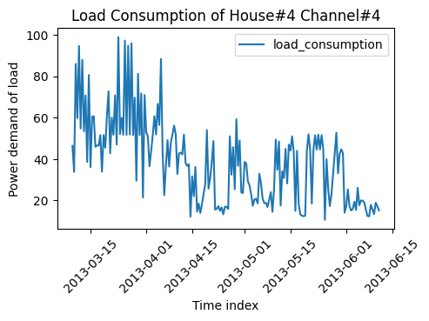
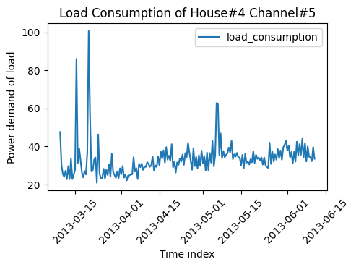
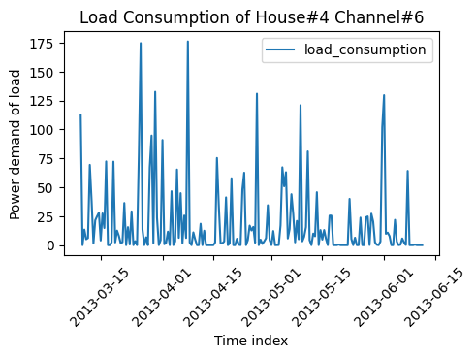
Sample Rate: 12 Hour

Slide 19
INSIGHTS
Channel#1,3,3,5 looks like actual time-series after we changed the sampling rate from 6s to 12 hour.
There are clearly a higher consumption spike at the march-April-may timestamps, so it might be caused by the weather or other impacts.
Sample Rate: 12 Hour

Slide 20
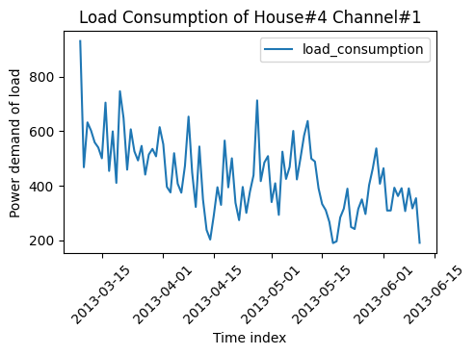
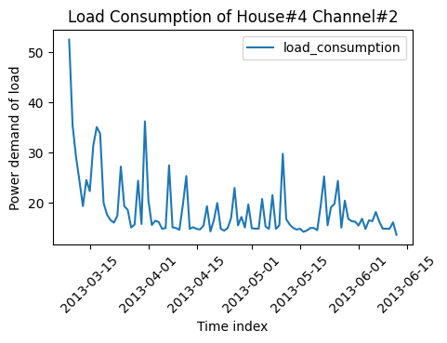
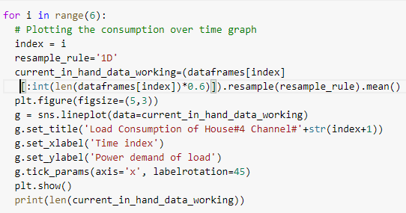
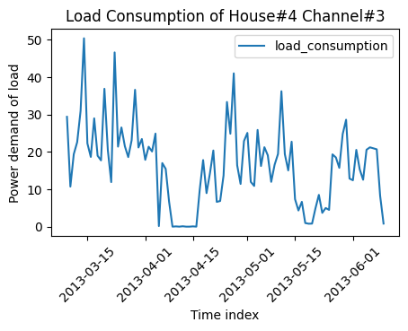
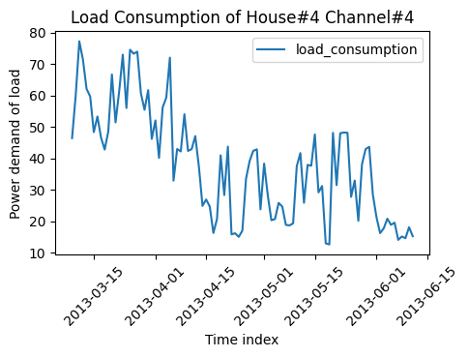
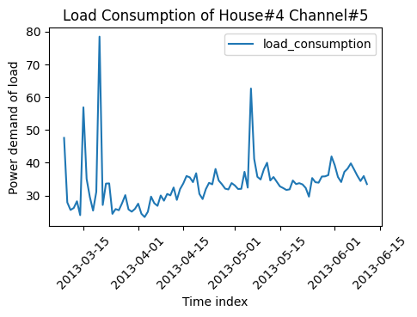
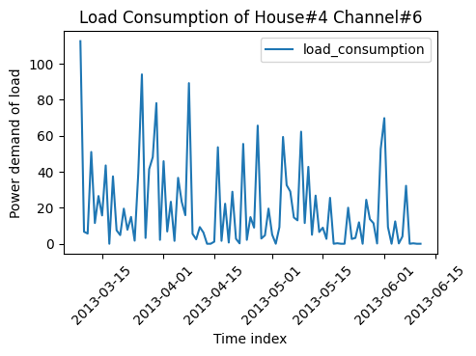
Sample Rate: 24H or Daily

Slide 21
INSIGHTS
Every channel now looks like expected time series, however, at the cost of down-sampling so much that the number of datapoints now is very low (Due to the too much relative smoothness of the LINEPLOT)
The more time goes, we can observe that power consumption of house#4 has a decreasing effect. This might be because the residents/test-subjects know they are being observed and thus behave differently unknowingly [Hawthorne effect]
The channel#3 now gives an important observation that at 1st quarter of April, the channel#3’s consumption was low. Which basically means kettle & radio usage was low.. Which in a privacy attacker’s P.O.V it mean that the tea addicted consumer(s) was not around during this period
Sample Rate: 24H or Daily

Slide 22
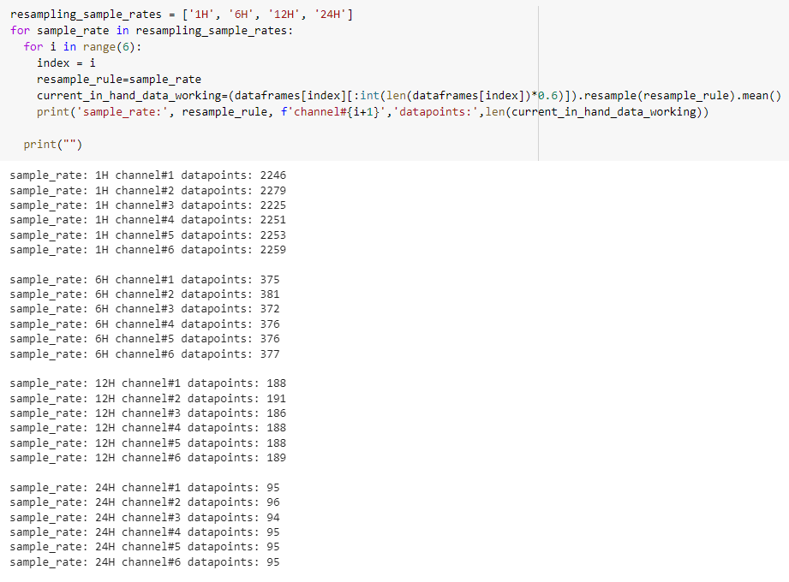
Finding out resampling data points reduction

Slide 23
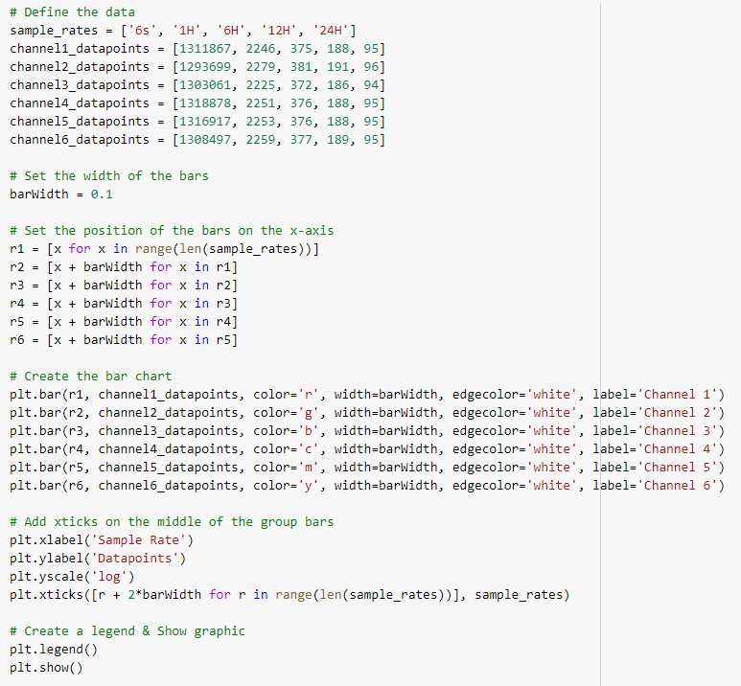
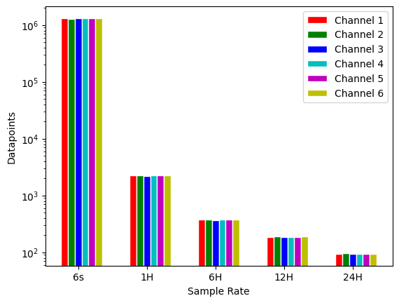
Resampling Tradeoffs

Slide 24
Resampling Tradeoffs
INSIGHTS
With every resampling’s sample rate increase the number of datapoints keep decreasing exponentially.
Which means The more the datapoints in the raw data, the better it is after resampling (i.e. with proper resampling we can do great forecasting with the larger house data such as house#1)
Initially we had 13 Lakhs which in turn reduced to around 2k after changing sample rate from 6s to 1H, so the first leap is the huge leap

Slide 25
Lets work with Aggregate Channel (#1) with sample rate of 24h only from now on…

Slide 26
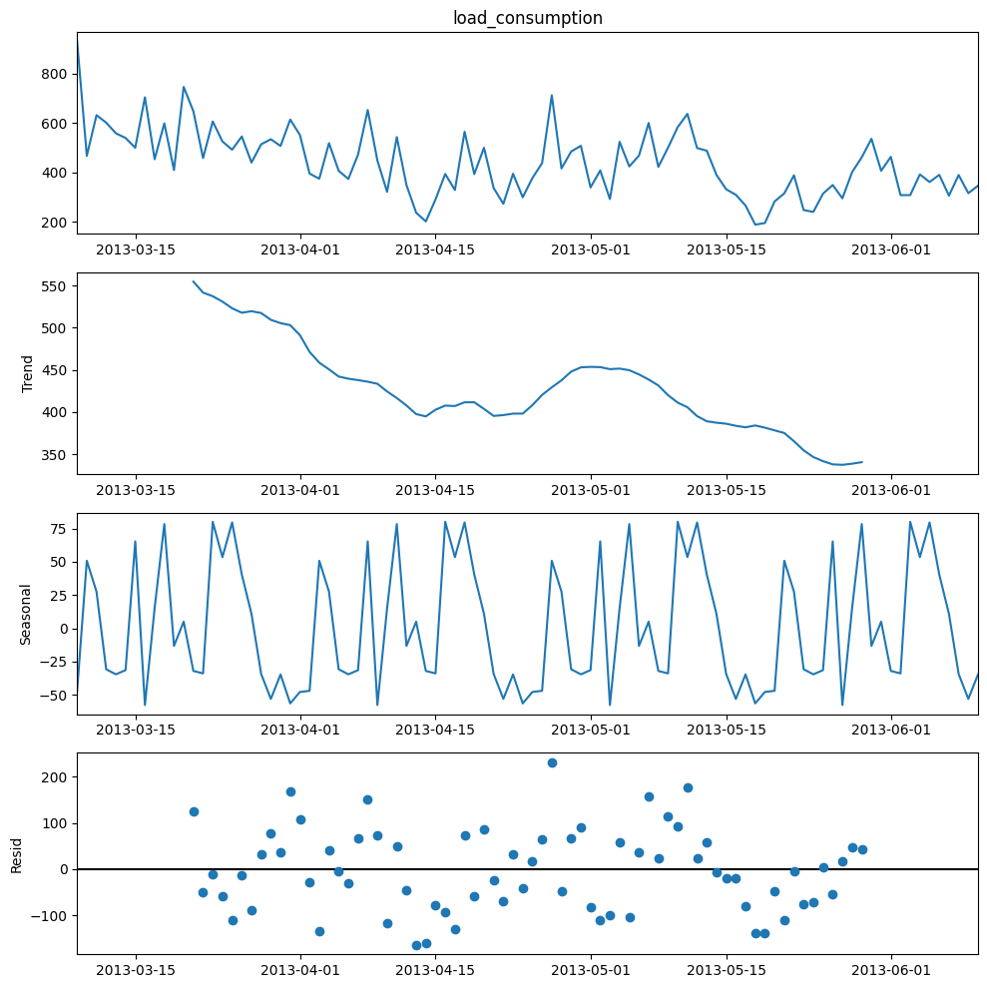
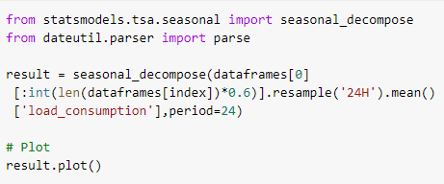
aggregate channel sample rate 24Hour

Slide 27
aggregate channel sample rate 24Hour
INSIGHTS
There is a downward trend, so the residents are decreasing the usage of electricity. After summer the users have reduced consumption or it may be the Hawthorne effect.
There are some seasonal components in the time series. So, we have to use SEASONAL_ARIMA if we use ARIMA as forecasting model.
There are some residual in the time series, which is due to human behavior changes or statistical error.

Slide 28
Lets interpret the ACF and PACF
Resource for understanding ACF and PACF:
https://edu.machinelearningplus.com/s/preview/courses/data-pre-processing-and-eda#617fbaad0cf26f3f0e0ce33d

Slide 29
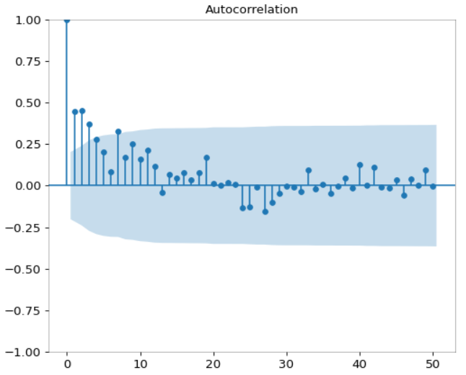
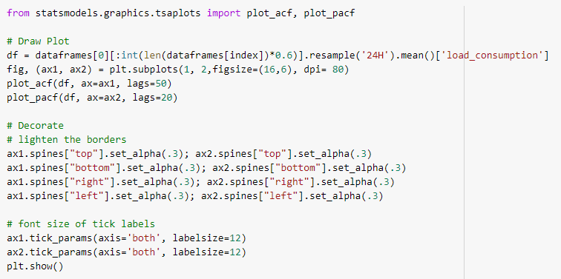
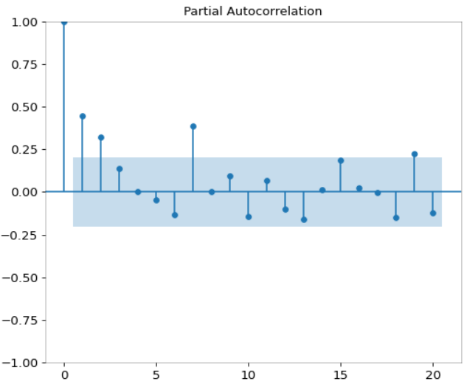

Slide 30
INSIGHTS
In ACF, we can see 4 past-values are above significance level, so past 4 values have heavy correlation with the current value in the time series than others. So, with a 24 hour sampling rate, we can think that only 4 days past value is of higher significance than the other ones.
In ACF, There is also a 8th lag/past value significance, which means the start of the week (before 7 days) carries a significance trend on the current value but its significance level is weak than previous four days.
The PACF tells us that 1st, 2nd,3rd, and 8th trend significantly contributes in deciding the current day’s power consumption. [This insight aligns with the ACF insights too]

Slide 31



Slide 32
INSIGHTS
1st quarter of the year has more load consumption than the year-ends.

Slide 33


1st quarter of the year has more load consumption than the year-ends.

Slide 34
INSIGHTS
1st quarter of the year has more load consumption than the year-ends.
While handling missing data, we have occluded some of the June datapoints

Slide 35



Slide 36
INSIGHTS
If we plot every channel together, then we can see that the channel#1 or aggregate channel carries over the information from all other datapoints. So,
we can only forecast the channel#1 to invariably forecast the other channels as well.

Slide 37



Slide 38
INSIGHTS
During Saturday, Sunday and Wednesday the residents use lowest amount of energy.
At Tuesday the residents use highest amounts of energy.
At Saturday, Sunday and Wednesday the residents seem to not stay at home at all given the trends observed here.

Slide 39
Summary of Directions that we got from EDA
Need to use resampling methods to down sample the dataset as a data preprocessing step.
We have to arrive at a tradeoff between down sampling and keeping more number of training samples during model training.
Use Seasonal ARIMA (SARIMA, Auto-SARIMA) in model training phase.
Only forecast channel#1 will suffice as it contains other channel’s information as well.
And Many more…

Slide 40
Model Run
ARIMA
SARIMA
LSTM
XGBOOST

Slide 41

Results

Slide 42





ARIMA Forecasting

Slide 43





LSTM Forecasting

Slide 44





XGBOOST Forecasting

Slide 45
Thank You
Shaiara Tabassum | Mosroor Mofiz Arman | Md Sahadul Hasan Arian

